Slide 1
Confined Space Awareness: What to Look For
Shipyard Safety Training

Slide 2
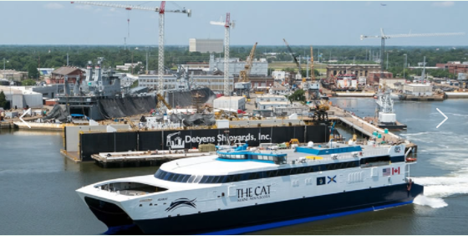
Instructors
NAME
Company
NAME
Company

Slide 3
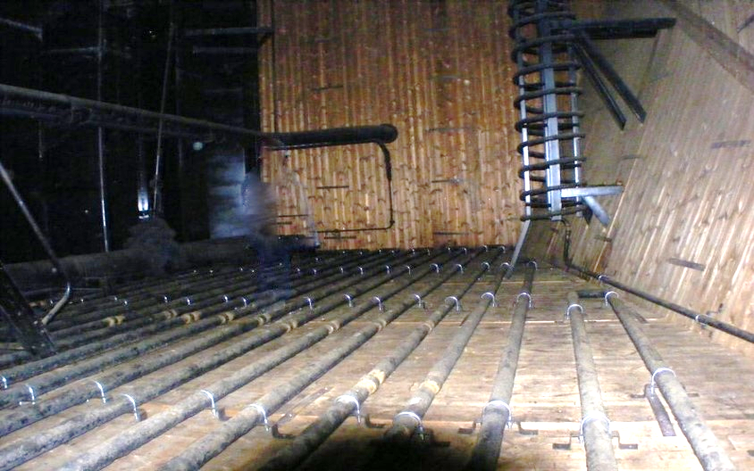
What is a Confined Space?
Any space not necessarily designed for people to live in
Large enough for workers to enter and perform required jobs
Has limited or restricted means for entry and exit
Always exposes workers to unsafe hazards

Slide 4
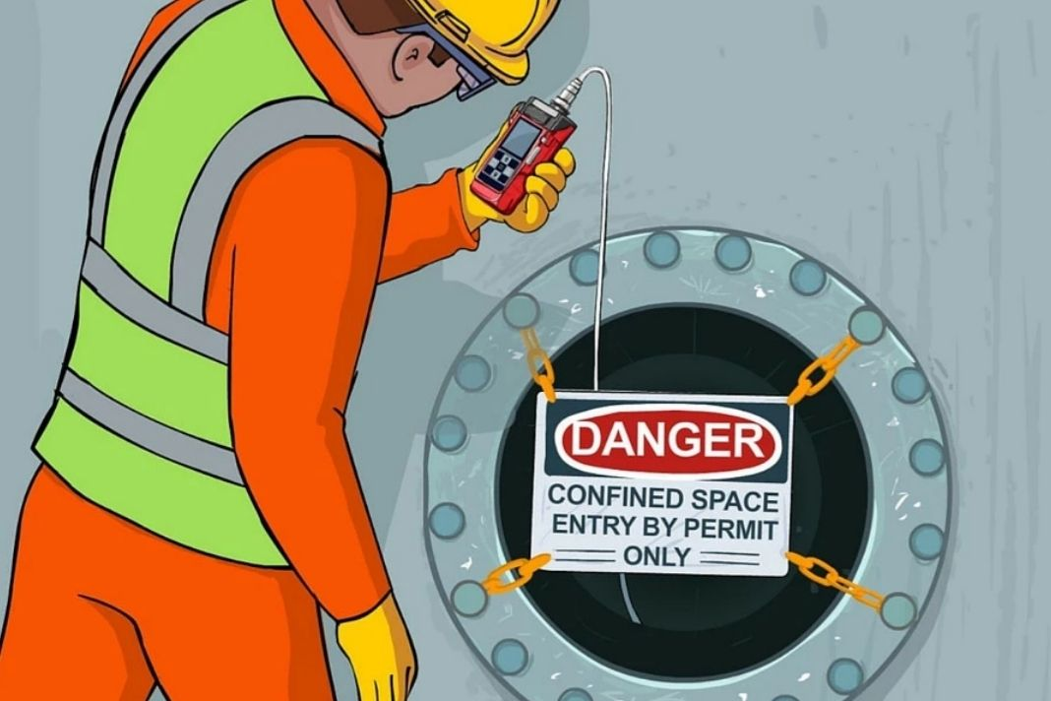
Why are confined spaces so hazardous?
Hard to get in and out of the space
Difficult to move in some spaces
Poor ventilation due to the lack of openings and tank configuration
Conditions can change very quickly inside the tank
Conditions outside the tank can impact the conditions inside the tank
Work activities almost always introduce additional hazards in the tank
Extremely poor communication (echoes, loud, long distances, etc.)
Self-rescue and first responder rescues are more difficult

Slide 5
Name the confined spaces on the picture below

Slide 6
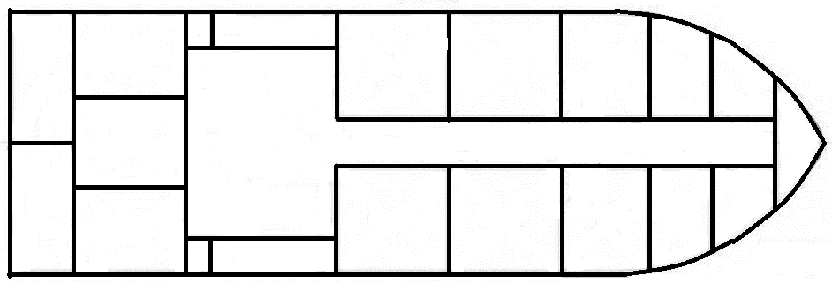
Confined and Enclosed Spaces
M/V Cross Thread (Supply Boat)

Slide 7
Confined and Enclosed Spaced
Barge – BC 123 (Gasoline Barge)

Slide 8
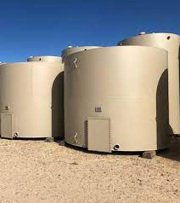
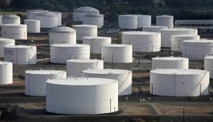
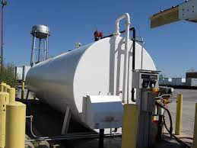
Are these tanks confined spaces?

Slide 9
What are some of the hazards found in confined spaces?
Hazard | Cause
Lack of Oxygen | Rust, Chemical Vapors, Fire, Decaying Marine Life
Toxic Vapors | Cargo Residue, Decaying Marine Life, Piping Runback
Biological | Sewage, Gray Water
Fire | Flammable/Combustible Materials and Gases
Electrical Shock | Extension Cords, Welding Leads, Lighting
Extreme Temperatures | Hot and cold ambient temperatures
Fall | Piping, Vessel Ladders, Girders, Scaffolding

Slide 10
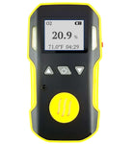
Confined Space Hazards
Lack of Oxygen
Rust – Iron Oxide or Fe2O3 = When steel is allowed to naturally combine with free oxygen, it forms rust
The first thing that must be checked for before entering ANY confined space is “how much oxygen is in the space”
You have officially “entered” a confined space when you break the plane of the entrance or opening
20.8% to 19.5% by volume is required to safely enter a space
An Oxygen Meter must be used to test for oxygen levels

Slide 11
What happens when entering a confined space with little or no Oxygen?
Oxygen Level | Physical Effects
15% - 19% | Impaired coordination
12% - 14% | Breathing increases with poor judgment
10% - 12% | Rapid breathing and lips begin to turn blue
8% - 10% | Unconsciousness and vomiting
6% - 8% | 5 minutes = possible recovery 6 minutes = 50% of victims die 8 minutes = fatal
4% - 6% | Coma within 40 seconds then fatal

Slide 12
Confined Space Hazards
Toxicity
Toxicity in spaces comes from cargo residue, decaying marine life, piping runback, liquids stored on the vessel
Toxicity is measured in Parts Per Million (PPM) by volume
What is one Part Per Million?
One business card lying in the middle on an NFL football field
One inch in 16 miles
One heartbeat in 27 years
One penny in $10,000 dollars

Slide 13
Confined Space Hazards
Toxicity
Threshold Limit Value (TLV) is how much you can be exposed to in an 8-hour time weighed average
Measured with a meter or sampling tubes
Types of chemicals common on vessels/shipyards and their TLVs:
Diesel = 15 ppm | Carbon Monoxide = 25 ppm | Benzene = .05 ppm
Methane Gas = 1000 ppm | Carbon Dioxide = 5000 ppm | Propane = 1000 ppm
Oil = 400 ppm | Nitrogen = 5 ppm | Paint Fumes = 1000 ppm

Slide 14
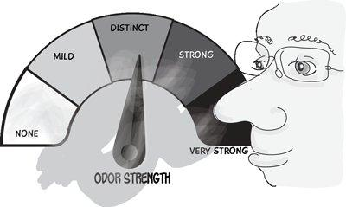
Parts Per Million Exercise

Slide 15
Confined Space Hazards
Biological
Tanks that hold sewage (blackwater) or wash water (greywater) must be tested by a Certified Marine Chemist
Tanks must be thoroughly cleaned and disinfected before entering
Workers must avoid skin contact by wearing special protective clothing, respirator, and face covering
Some vessel treat the blackwater tanks with chemical agents to speed up the decomposition, adding another hazard of exposure to the cleaning crew
Decomposing sewage will create both Methane and Hydrogen Sulfide gas which are highly flammable and toxic at low concentrations

Slide 16
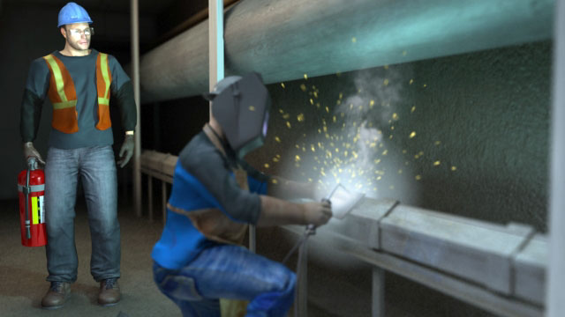
Confined Space Hazards
Fire
No hotwork can be performed within, on, or immediately adjacent to spaces, and pipelines that last contained or carried fuels, flammable liquids or gases until a certified Marine Chemist has tested and certified the space safe for hotwork.
A confined space must be cleared of any flammable or combustible materials before hotwork can be performed.
When flammable or combustible materials cannot be removed, they must be protected by protective cloth and a firewatch posted in the immediate area.

Slide 17
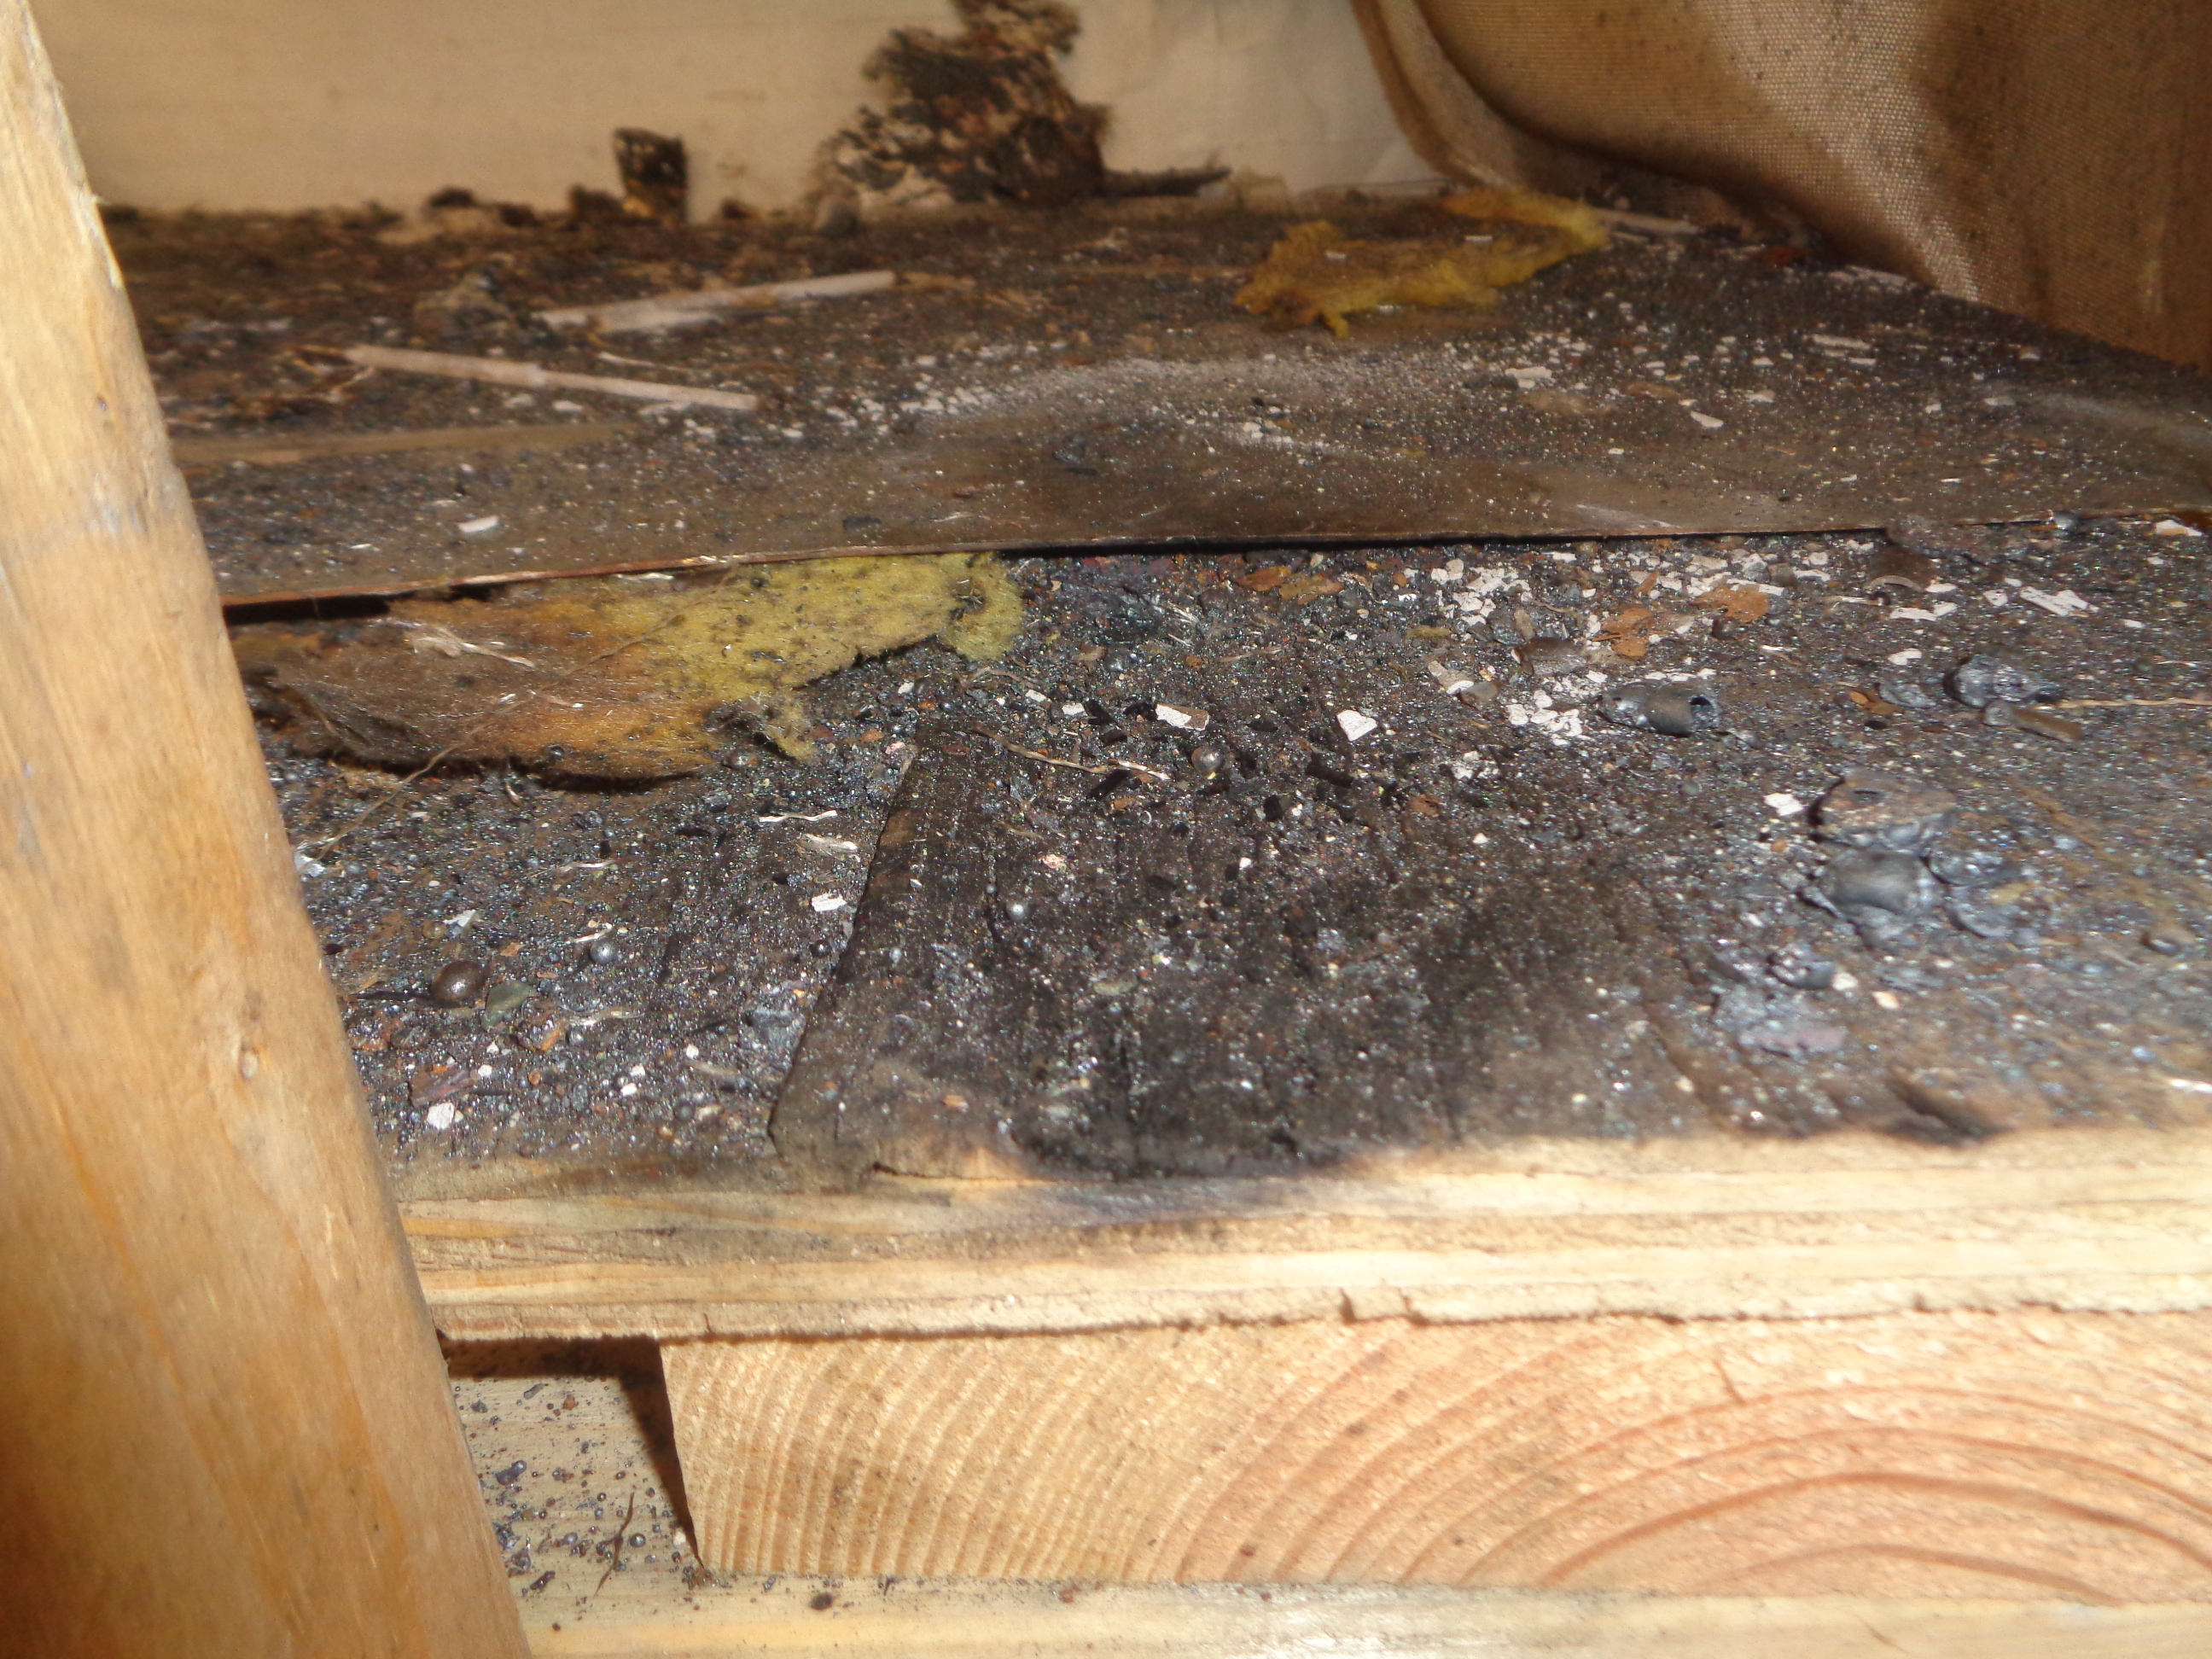
Confined Space Hazards
Fire
What are some fire hazards we should look for in confined spaces?
Wood
Insulation
Flammable gas
Plastic Sheeting
What is the difference between fire resistant and fire retardant?
Fire Resistant – self-extinguishing
Fire Retardant – chemically treated slow burn
Paint
Clothing
Trash
Plastic Buckets

Slide 18
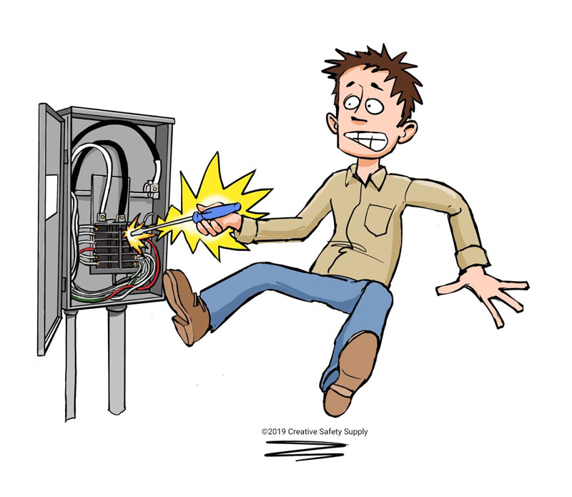
Confined Space Hazards
Electrical Shock
Electrical shocks happen when live current passes through the body trying to find the easiest path to ground
Most electrical shocks are caused by damaged or faulty wiring of equipment
Required to perform a daily inspection of all equipment we use prior to beginning work which includes all electrical equipment
Electrical shock hazards inside of confined spaces are created by our own work processes

Slide 19
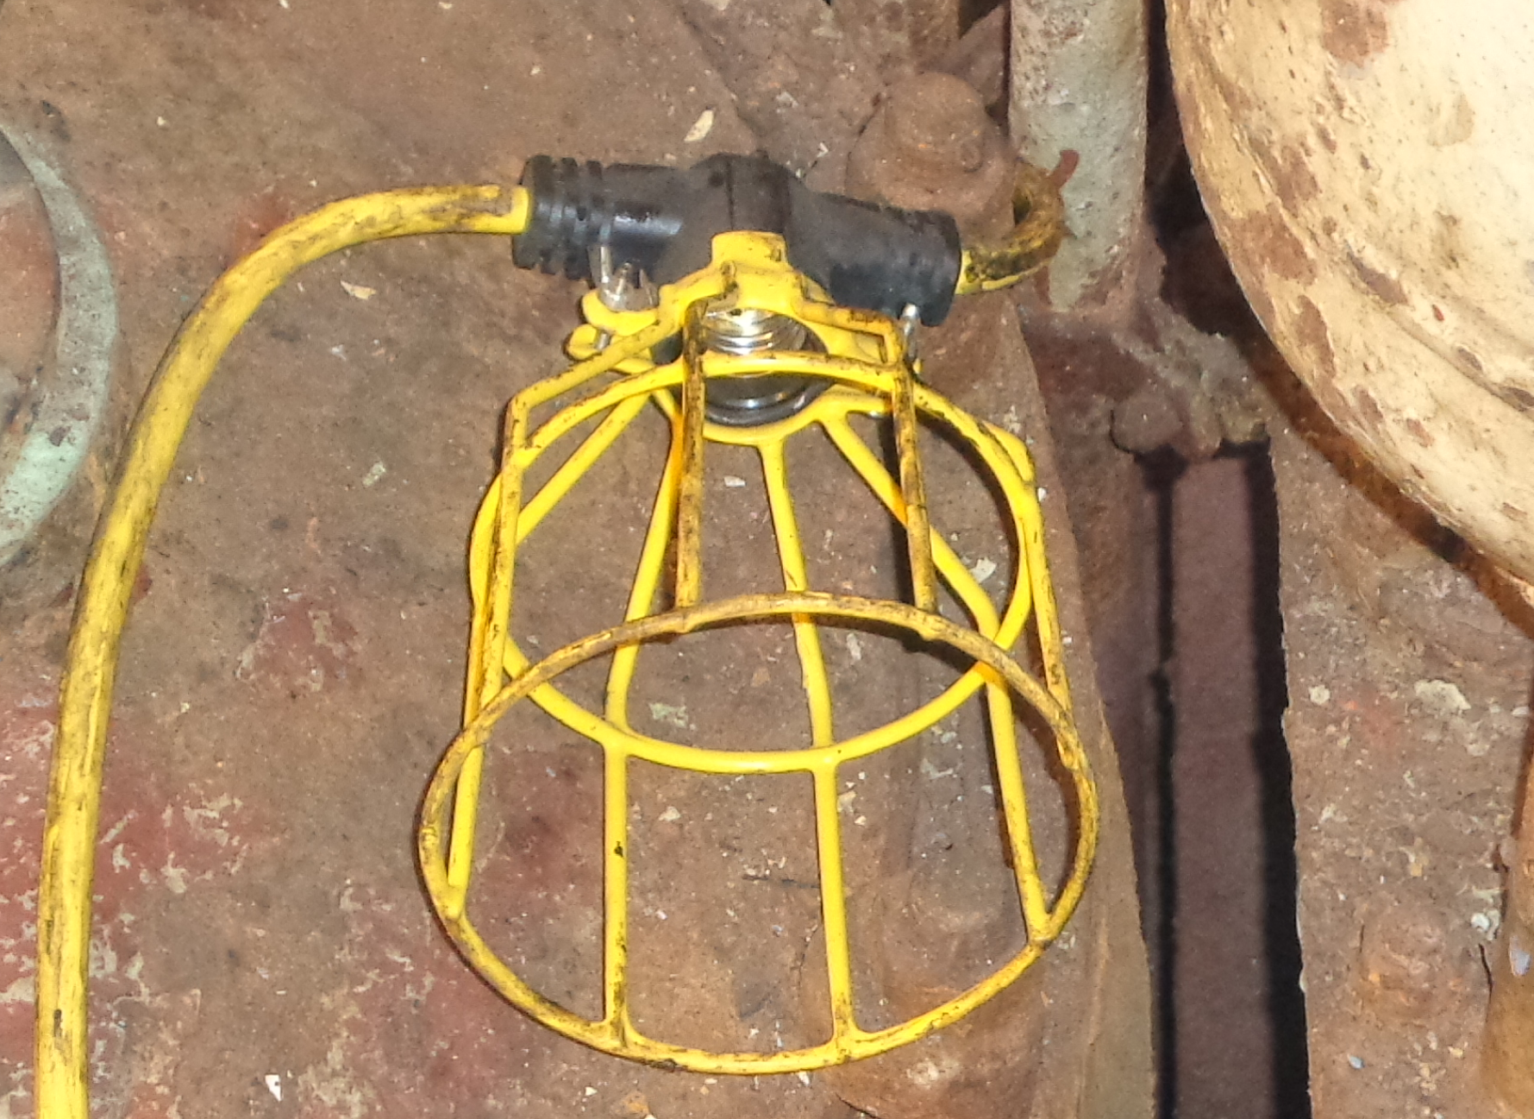
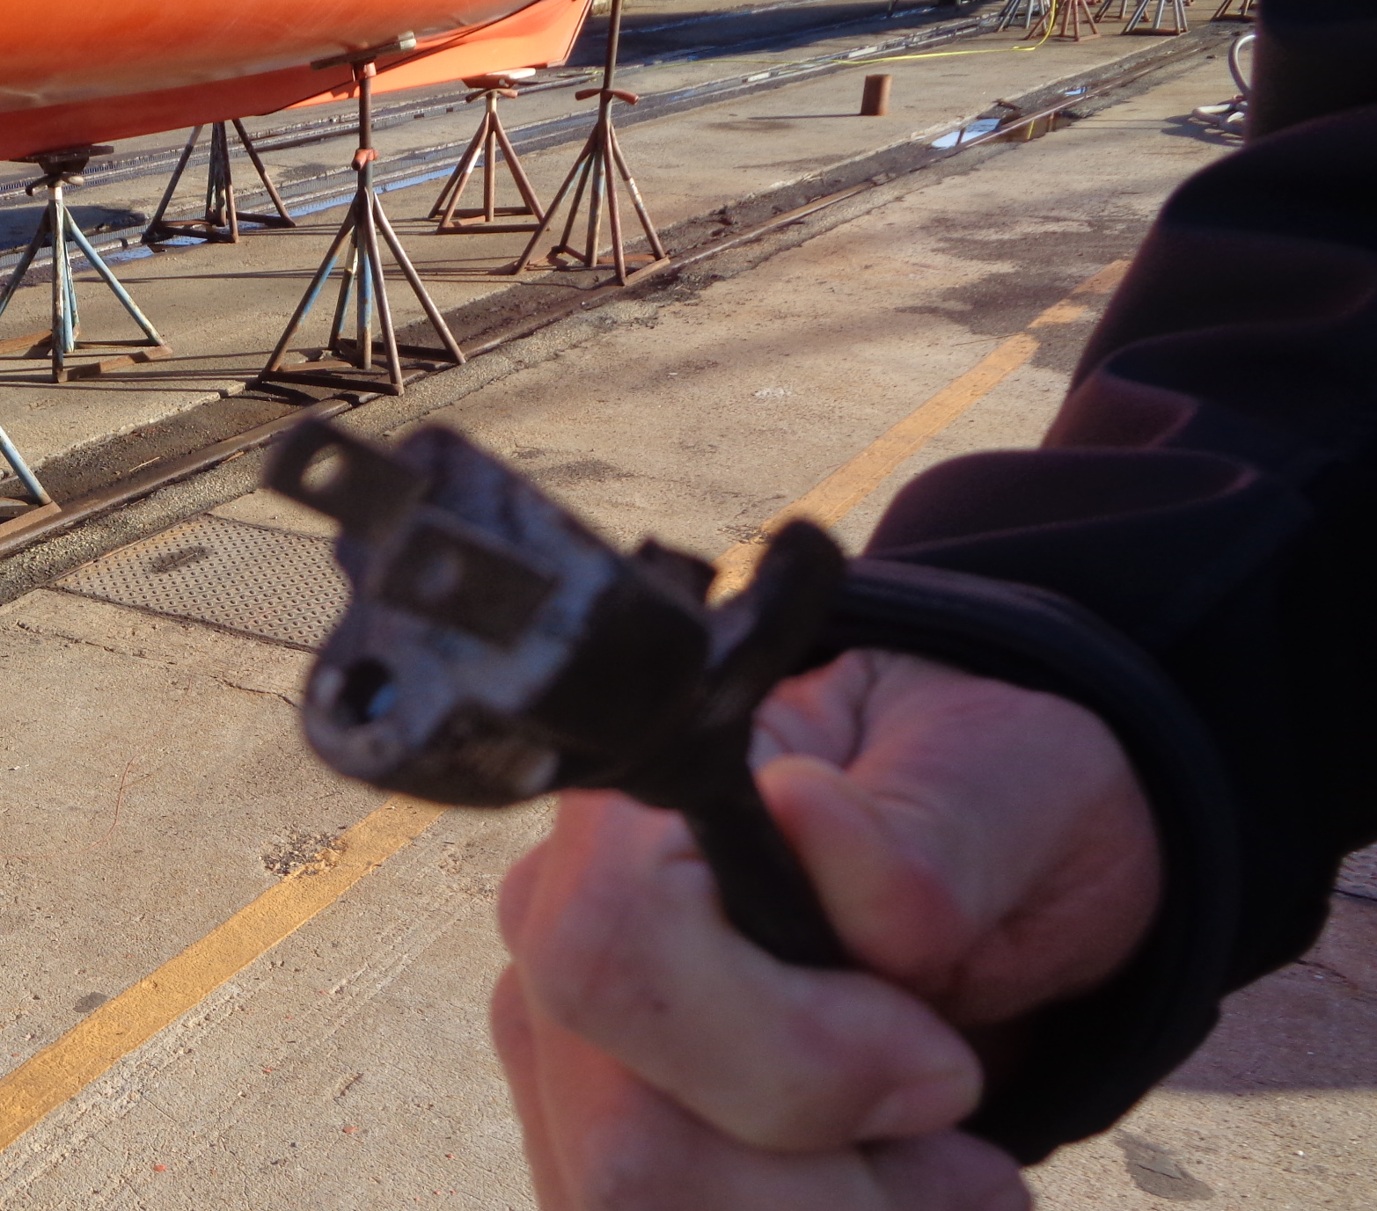
Confined Space Hazards
Electrical

Slide 20
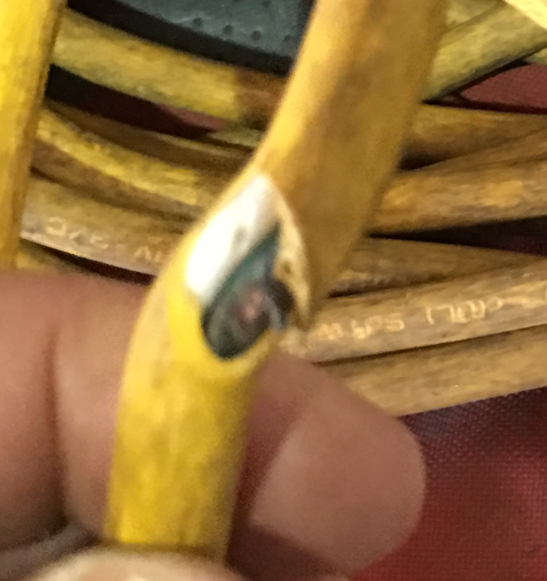
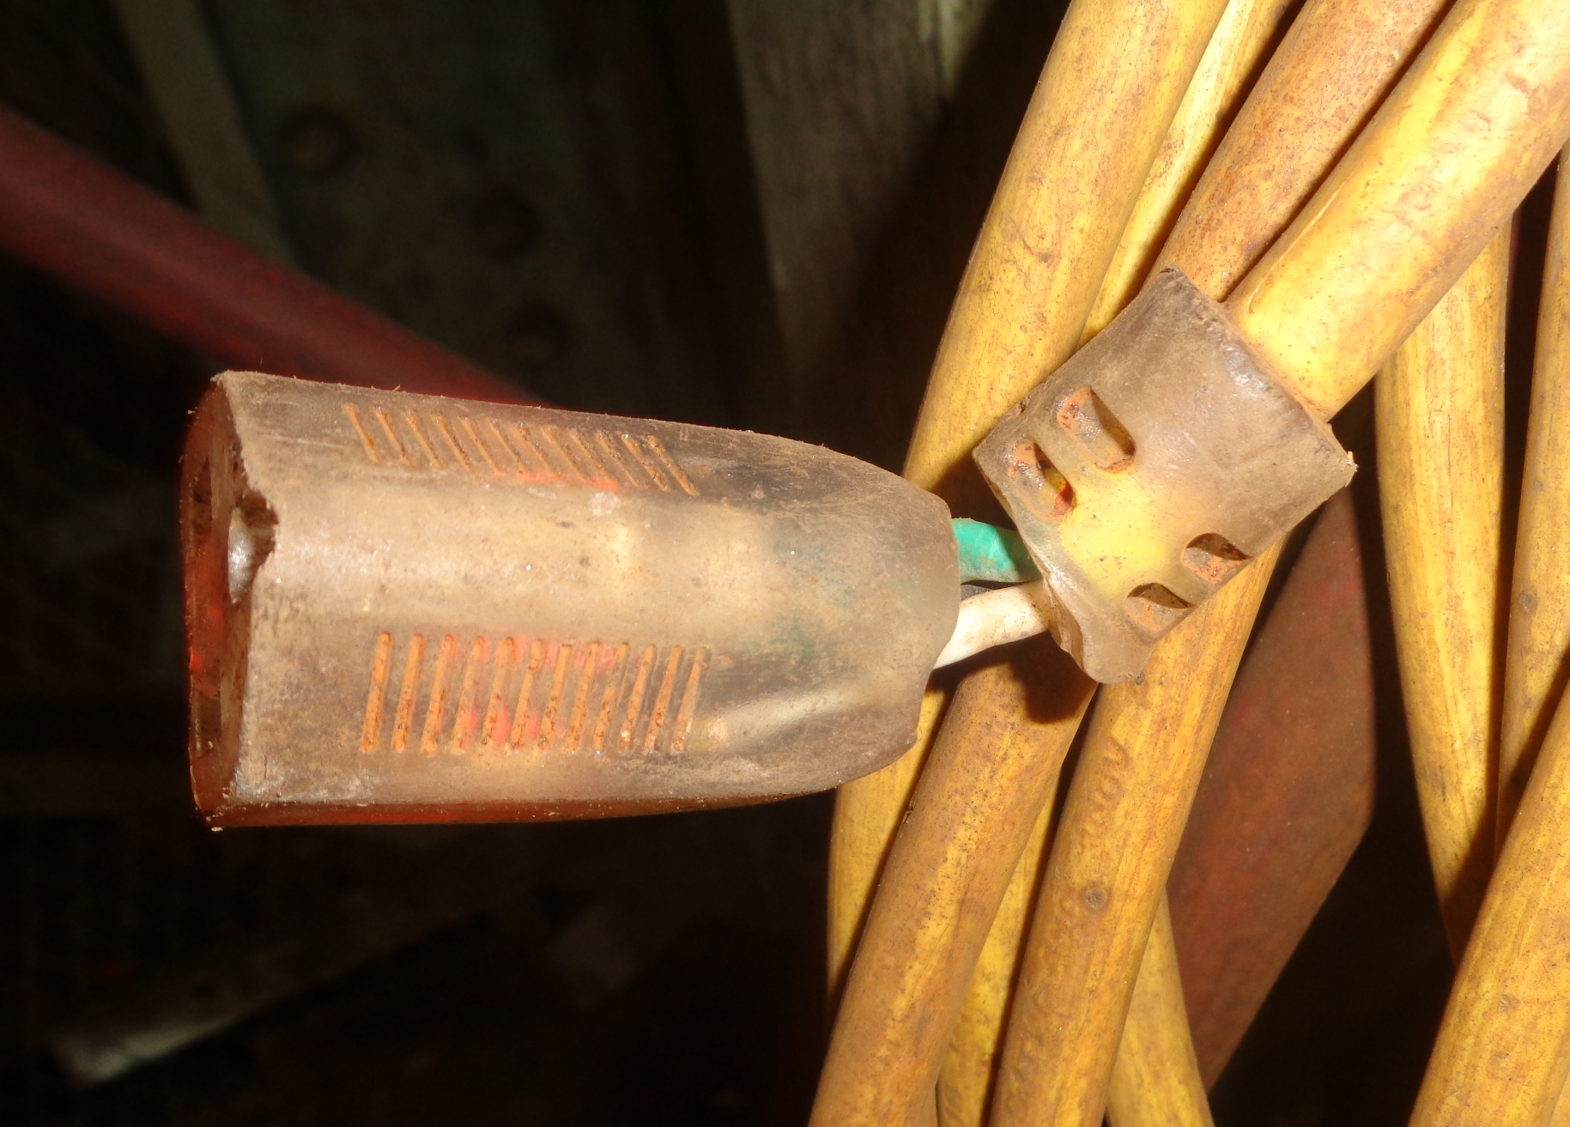
Confined Space Hazards
Electrical

Slide 21
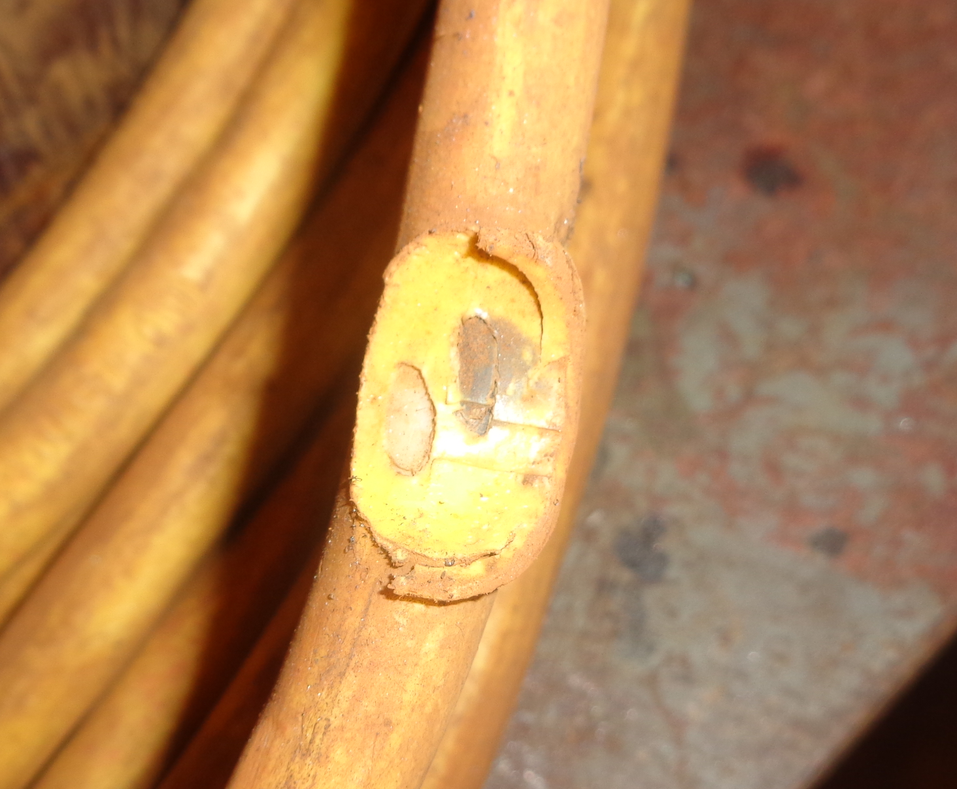
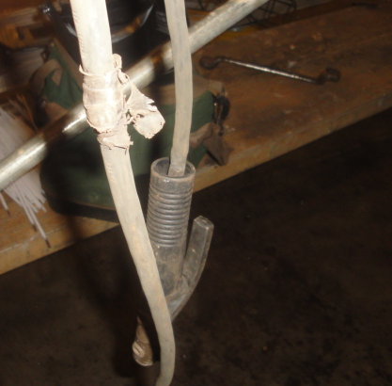
Confined Space Hazards
Electrical

Slide 22
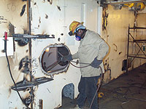
Confined Space Hazards
Extreme Temperatures
Radiant heat transfer is the number one heat source for confined spaces in a shipyard due to direct sunlight. What is number two?
Direct sunlight in a confined space can increase the ambient temperature inside the space by as much as 30%
What does radiant heat transfer mean while working in spaces?

Slide 23
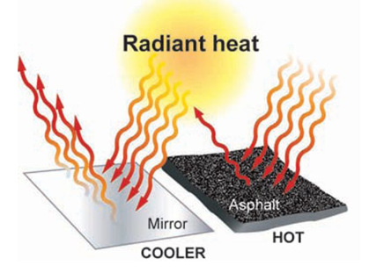
Confined Space Hazards
Extreme Temperatures
The average temperature in the month of July is 89°. Once the Ambient temperature inside of the space reaches 89°, the radiant heat transfer takes over and the space begins to absorb the heat. So, a 30% increase equals 116° inside the space.
Add in the heat from torches/welding/PPE and the space can reach 125° to 130°
The same process happens with cold temperatures
Where in a space is the highest temperature going to be?

Slide 24
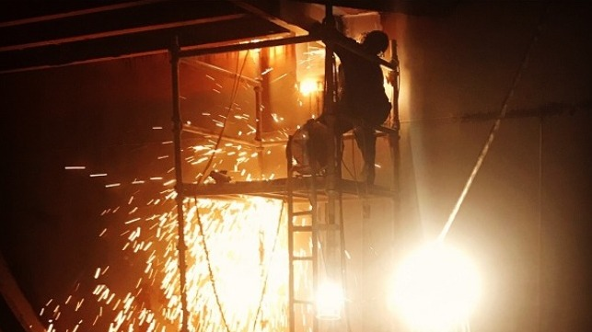
Confined Space Hazards
Fall Hazards
Fall injuries are the #2 cause of injuries for ALMA members, with automobile accidents being #1
Average claim cost of a fall injury over the last five years is $70K, with an average yearly payout of $19 million
According to National Safety Council, 60% of all fall injuries happen on the same level, the other 40% happen while climbing
What is more hazardous: climbing down or climbing up?

Slide 25
Confined Space Hazards
Fall Hazards
How can we prevent fall injuries?
Be aware of your surroundings
Keep your feet under your weight as much as possible
Take your time climbing stairs and ladders
Secure all ladders before use
Make sure perimeter fencing is adequately installed and in place
Inspect your fall harness for any defects
Make sure you have a secure attachment point for fall harnesses

Slide 26
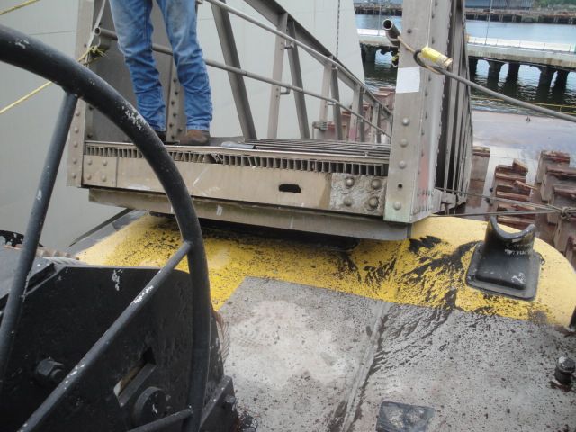
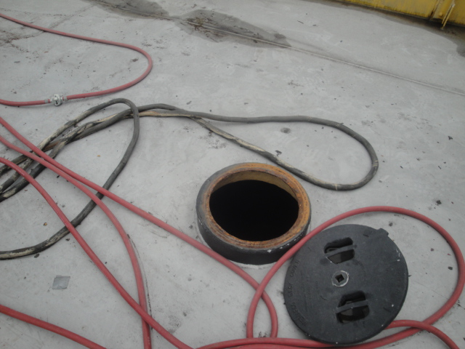
Confined Space Hazards
Fall Hazards

Slide 27
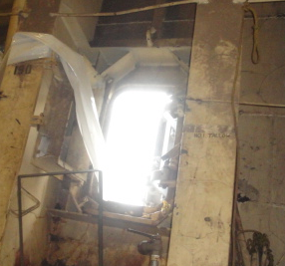
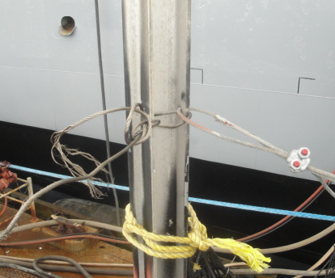
Confined Space Hazards
Fall Hazards

Slide 28
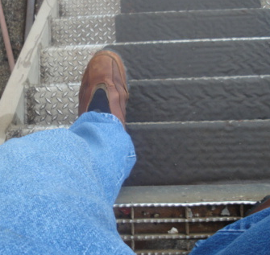
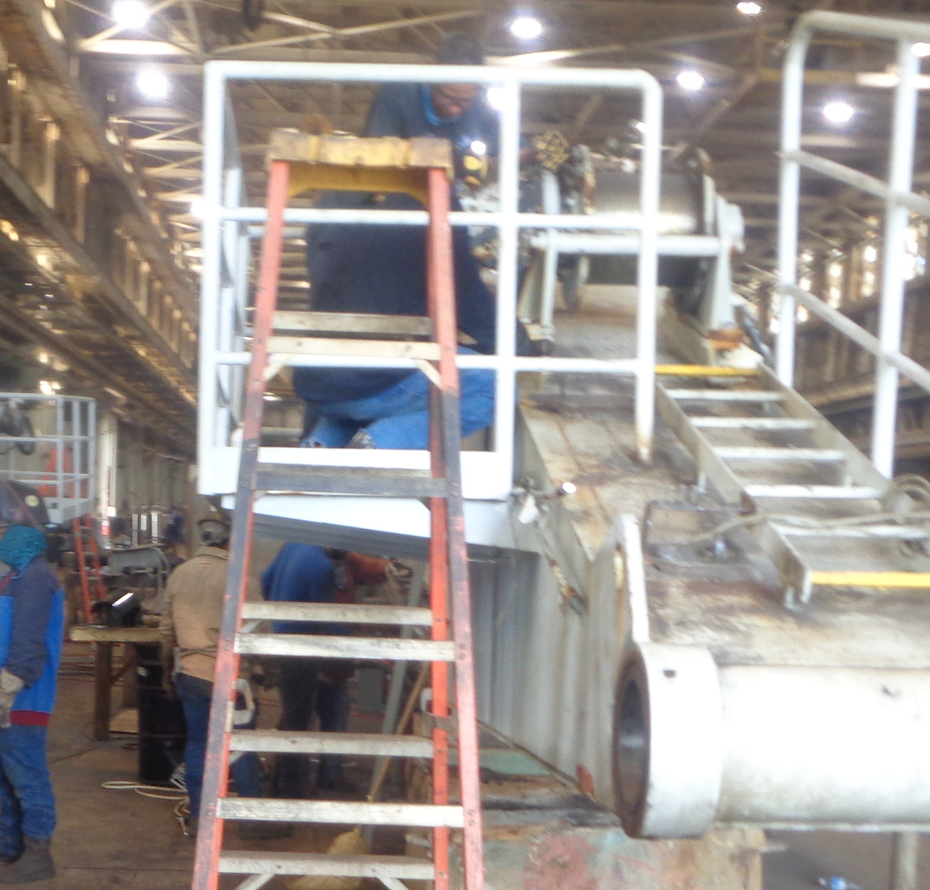
Confined Space Hazards
Fall Hazards

Slide 29
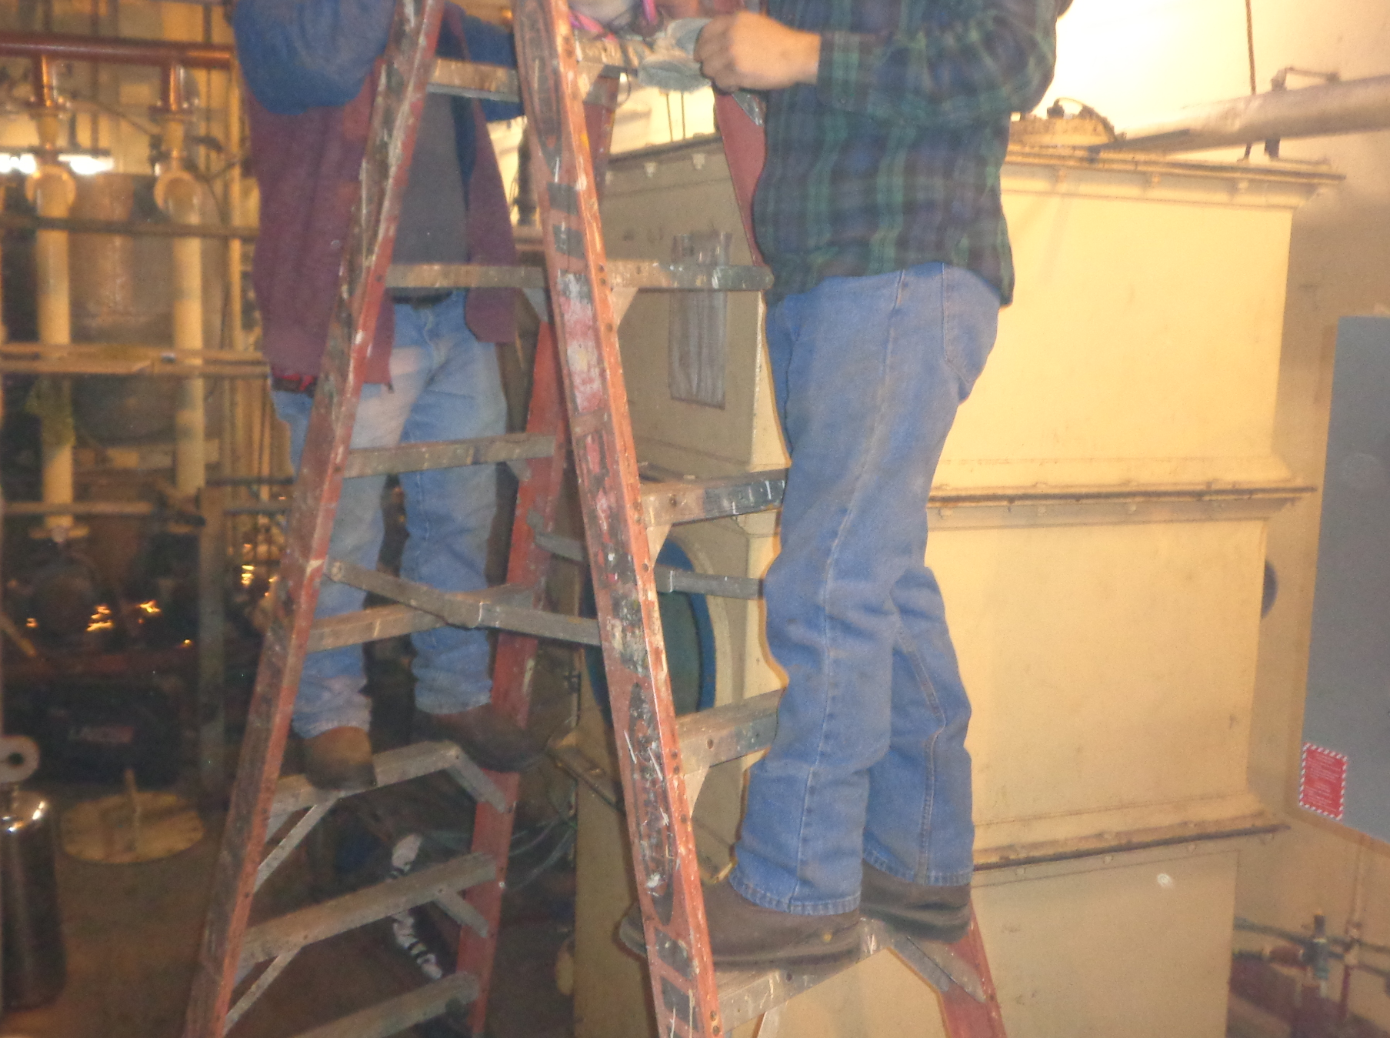
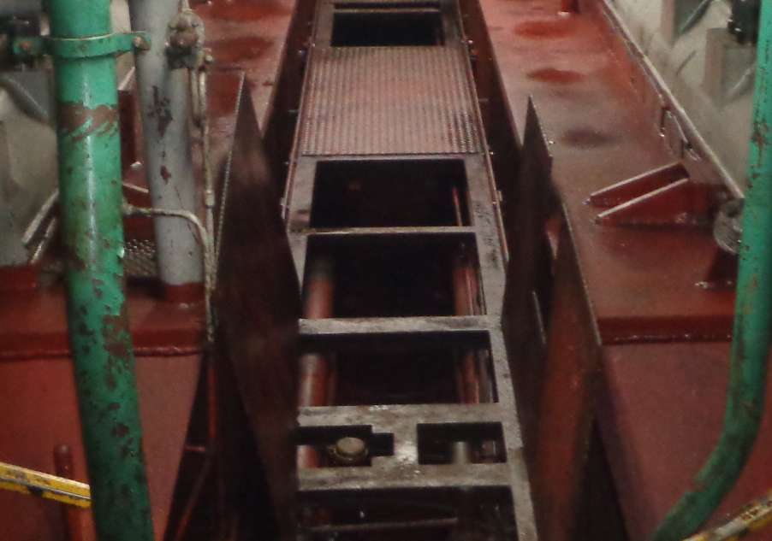
Confined Space Hazards
Fall Hazards

Slide 30
Confined Space Hazards
Summary
Confine spaces are very hazardous
Before sending workers in confined spaces, make sure they understand the hazards
Have employees report any hazardous conditions immediately
Check the atmosphere before entering any confined space, if you’re not sure if the space has been tested, call someone to check it
Maintain good housekeeping inside of spaces
When in doubt, stop work and make sure it is safe!

Slide 31
Confined Space Hazards
Summary
Both investigations and inspections are equally important
Pick something in your area of responsibility and conduct an accident investigation using a “Fishbone Blueprint”
Develop a prevention plan for any unsafe condition
Communicate your prevention plan to all your workers
Assign someone to perform a safety inspection looking for one or two unsafe conditions from your plan
The only way to get better is to use it

Slide 32
Questions/Comments

Slide 33
Thank you!

